Slide 1
Transcript Request Process
The Transcript Request Process applies to:
- all colleges that you apply to
- scholarship applications that require an official transcript
Requests need to be submitted AT LEAST THREE weeks BEFORE to the application deadline
Transcript Request forms are turned in to Mr. Villatoro (in the Student Services Office)

Slide 2
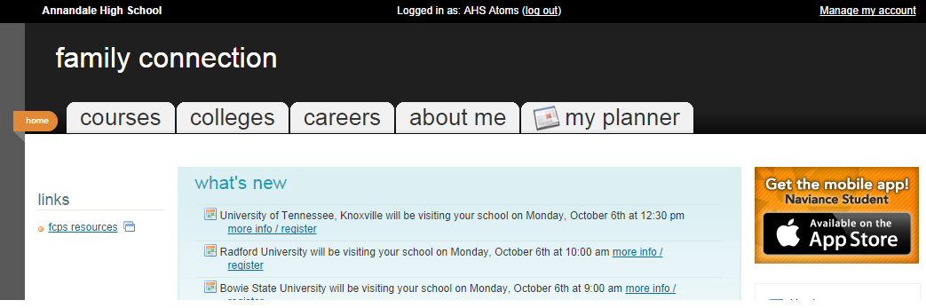
Step 1: Add your colleges to Family Connection
Log on to Family Connection
Click on the Colleges tab
Click on “colleges I’m thinking about”
Keep your list of colleges current
Pay attention to deadlines, note the type of application you’ll be submitting
  (Electronic, Common App, or Regular Mail)

Slide 3
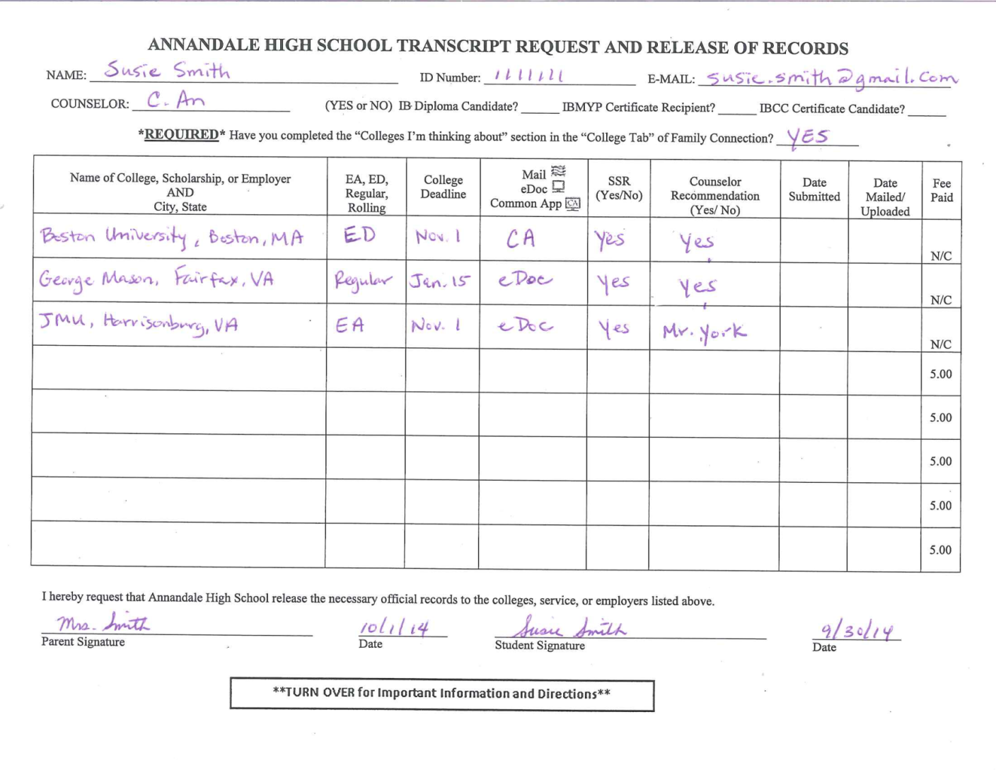
Transcript Request Form, Page 1
Step 2: Complete the Transcript Request Form

Slide 4
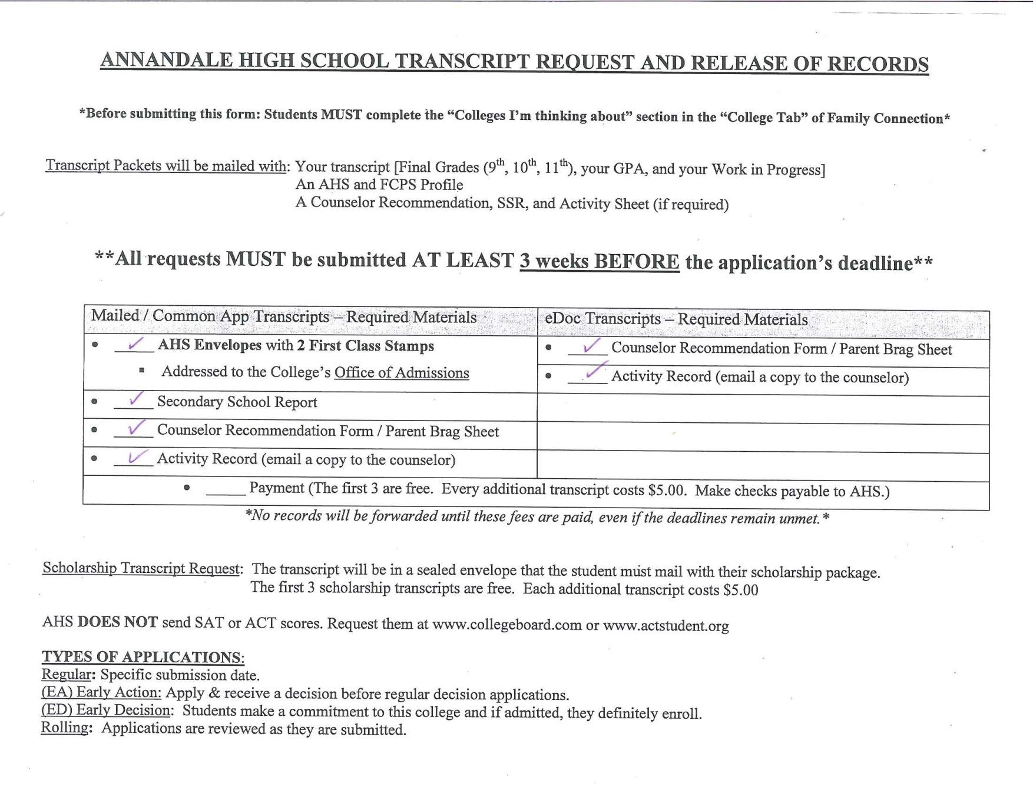
Transcript Request Form, Page 2

Slide 5
Transcript Delivery Methods
Electronic
  (eDocs) =
2. Paper Transcript
  Common Application =
  Old Fashion USPS aka “snail mail” =

Slide 6

Step 3. Complete action items
For eDoc transcripts
  Recommendation letter from your counselor
    Complete and submit the Counselor and Parent Brag Sheets
    Note: Your Counselor’s letter will be uploaded with your transcript
  Recommendation letter from a teacher
    Check the college requirements if you need to enter in your teacher’s email address or if they want the letter to be sent in the mail
    If the college wants the letter sent in the mail, give teacher an AHS envelope with the college(s) address(es) and 1 first class stamp
    Make sure teacher knows your application deadlines
    Note: Teacher(s) will mail their letter(s) independently (snail mail)
  Email your Activity Sheet to your counselor

Slide 7
Step 3. Complete action items cont.
For Common App transcripts
  Submit the following documents w/ the Transcript Request Form:
    3-page Secondary School Report form (1 copy), printed from the Common App web site
    Fee Waiver if you receive Free/Reduced Lunch and you indicate so on the Common App
    AHS envelope(s), with college address(es) and 2 first class stamps
    a printed copy your Activity Record
  Recommendation letter from your counselor
    Through the Common App web site, “assign” your counselor as a Recommender in the FERPA/Recommender Section
      (you’ll need to enter your counselor’s email address in the Recommender Section so be sure to get his/her correct email address
    submit the Counselor Brag sheet and Parent Brag Sheet (required) ASAP
    Note: Your counselor’s letter will be mailed with your transcript (snail mail)
  Recommendation letter from a teacher
    Through the Common App web site, “assign” a teacher as a Recommender by providing your teacher’s email address in the FERPA/Recommender Section
    Note: Teachers can submit their letters through the web site

Slide 8
Step 3. Complete action items cont.
For “snail mail” transcripts
  Submit the following documents w/ the Transcript Request form:
    a printed copy your Activity Sheet
    AHS envelope(s), with college address(es) and 2 first class stamps
  Recommendation letter from your counselor
    submit your Counselor and Parent Brag Sheets to your counselor
    Email your counselor your Activity Sheet
  Recommendation letter from a teacher
    Give teacher an AHS envelope with college(s) address(es) and 1 first class stamp
    Make sure teacher knows application deadlines
    Note: Teacher(s) will mail their letter independently (snail mail)

Slide 9
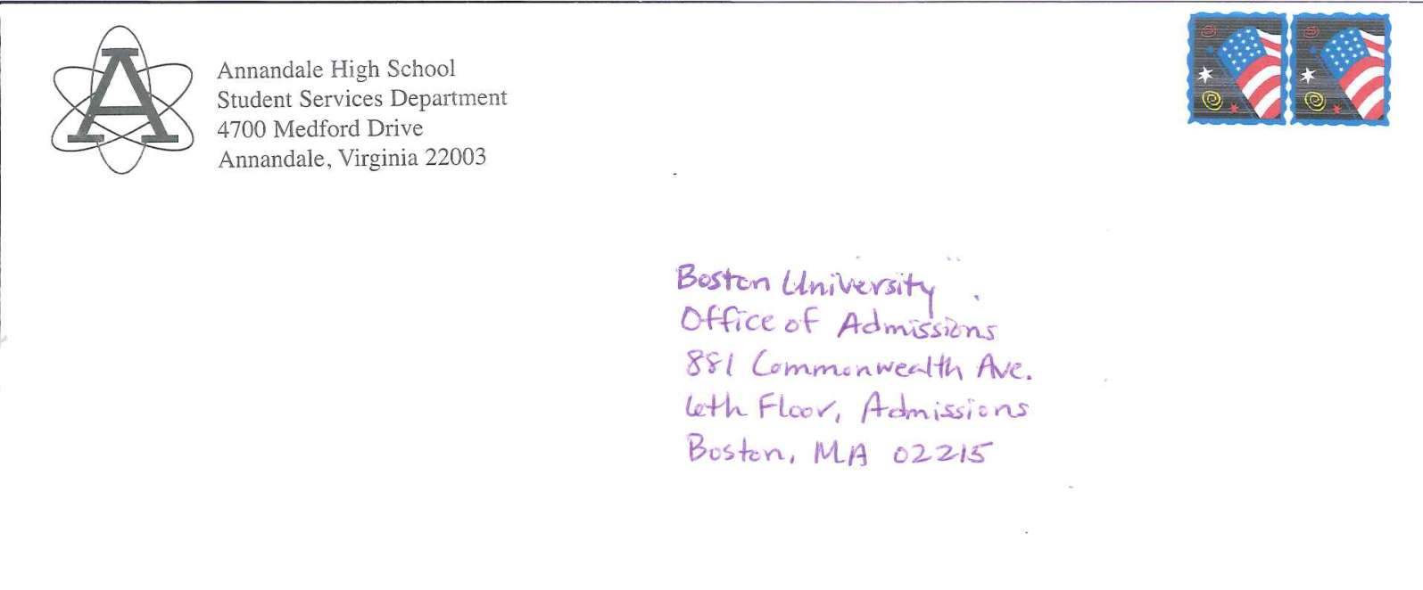
AHS Envelopes
Located on a shelf in Student Services Office
For Common App/Snail Mail transcript requests: Address the envelope and put 2 first class stamps on it
For teacher recommendation letters that will be sent out by teachers: Address the envelope and put 1 first class stamp on it

Slide 10
Some extra information to remember…

Slide 11
RECOMMENDATIONS
If you want a teacher or a counselor to write a letter of recommendation for you (for a college and/or for a scholarship) you must do the following:
  Ask the teacher or counselor if they’d be willing to write you a letter of recommendation
  Be sure to ask him/her AT LEAST THREE WEEKS BEFORE the college/scholarship deadline
  Provide the teacher/counselor with information including:
    Your activity sheet
    Deadline
    Information about the scholarship (if applicable)
    Stamped, addressed envelope(s) (if applicable)
  Be sure to thank the teacher/counselor afterwards (and let them know the outcome of your application ☺)

Slide 12
Recommendation Letters for JMU & VA Tech ONLY
JMU & VA Tech will accept ONLY ONE letter of recommendation and it MUST be sent with your transcript
For these schools, specify which person will be writing the letter under the “Counselor Recommendation” column on the Transcript Request form (either write your counselor’s name if you want him/her to write the letter, or write the name of the teacher who will be writing your letter)
If you ask a teacher to write your recommendation letter, ask him/her to give the letter to your counselor no later than 3 weeks before the college application deadline (it’s preferred that they turn it in to your counselor around the same time you turn in your transcript request form ☺)

Slide 13
If you have any questions about completing the transcript request form, please email or stop by your counselor’s office so he/she can help you.
☺

